Slide 1


Vedic Maths and Simplification Session No.: Course Name: Course Code: O1UA422L Instructor Name: Duration: 50 Mins Date of Conduction of Class:

Slide 2

Learning Outcome:
Learning Outcome 1: Apply Vedic Maths techniques to perform faster calculations useful for aptitude exams.
Learning Outcome 2: Simplify arithmetic expressions using BODMAS rules and short-cut methods for aptitude exams.

Slide 3
Vedic Mathematics
VINCULAM
Multiplication & Division with powers of 5
Multiplication with series of 1s
Multiplication with series of 9s
Multiplication of 2-digit and 3-digit numbers
Squares of 2-digit numbers: Base Value & Face Value Method
Square root
Cubes
Cube root

Slide 4
VINCULAM - A shortcut method for solving addition-subtraction based problems
Example: 125-438+759-367-276+493
Normally, we solve these types of questions in three steps. In the first step, we add all positive numbers. In second step, we add all negative numbers. In final step, we take the difference of the two results obtained in the previous two steps.
Using VINCULAM method (A bar over the number is the symbol of VINCULAM), these types of questions can be solved in one or two steps. Please watch the method below:
Consider the calculation of Unit digit: 5-8+9-7-6+3= -4 or . As we get a negative result, we compliment it from 10, write 10-4=6 and carry -1. Now consider the calculation of Tens digit: carry -1+2-3+5-6-7+9=-1, write 10-1=9 and carry -1. Contd…..

Slide 5

VINCULAM - A shortcut method for solving addition-subtraction based problems
Now consider the calculation of Hundreds digit: carry -1+1-4+7-3-2+4=2.
Therefore, 125-438+759-367-276+493=296
Example: 378-174-677+256-779-218
Consider the calculation of Unit digit: 8-4-7+6-9-8= -14. This time it is greater than 10 in magnitude. So, we compliment it from 20, write 20-14=6 and carry -2. Now consider the calculation of Tens digit: carry -2+7-7-7+5-7-1=-12, write 20-12=8 and carry -2.
Now consider the calculation of Hundreds digit: carry -2+3-1-6+2-7-2=-13.
If we get a (-) result in the end, only then we need second step.
Therefore, means -1300+86 = -1214
In case of positive results, complimenting will not be required.
Example: 378-124-617+286 calculated unit digit = 3. For Tens digit 7-2

Slide 6
MULTIPLICATION BY 5, 25, 125
for 5, multiply number by 10 and divide by 2
for 25, multiply number by 100 and divide by 4
for 125, multiply number by 1000 and divide by 8.

Slide 7
APPLICATIONS
1. Find the product 136 x 5?
A) 595 B) 650 C) 680 D) 740
2. Find the value of 48 x 5?
A) 240 B) 360 C) 320 D) 260
Notes:
Correct Option: C
Correct Option :A

Slide 8
APPLICATIONS
3. Find the product 36 x 25?
A) 935 B) 765 C) 900 D) 245
4. Find the value of 124 x 25?
A) 3100 B) 3000 C) 3200 D) 3150
Notes:
3. Correct Option: C
4. Correct Option: A

Slide 9
APPLICATIONS
5. Find the value of 640 x 125?
A) 800000 B) 80000 C) 8000 D) None
6. Find the value of 152 x 125?
A) 19200 B) 15200 C) 19000 D) 18000
Notes:
5. Correct Option: B
6. Correct Option: C

Slide 10
DIVISION BY 5, 25, 125
for 5, multiply number by 2 and divide by 10.
for 25, multiply number by 4 and divide by 100.
for 125, multiply number by 8 and divide by 1000.

Slide 11
APPLICATIONS
7. Find the value of 840 / 5?
A)268 B) 168 C) 328 D) None
8. Find the value of 152 / 5?
A) 31.4 B) 32.4 C) 30.4 D) 33.4
Notes:
7. Correct Option: B
8. Correct Option: C

Slide 12
APPLICATIONS
9. Find the value of 284 / 25?
A) 12.16 B) 11.36 C) 10.26 D) None
10. Find the value of 452 / 25?
A) 18.28 B) 18.18 C) 18.08 D) 18.38
Notes:
9. Correct Option: B
10. Correct option: C

Slide 13
APPLICATIONS
11. Find the value of 64000 / 125?
A) 522 B) 412 C) 612 D) None
12. Find the value of 5860 / 125?
A) 48.88 B) 56.88 C) 46.88 D) None
Notes:
11. Correct Option: D(512)
12. Correct Option: C

Slide 14
MULTIPLICATION OF NUMBERS WITH SERIES OF 1’s: 1, 11, 111….
MULTIPLY BY 11:
Step 1: Write the rightmost digit as it is.
Step 2: We add digits to the left in pair of 2.
Step 3: Repeat step 2 till leftmost digit.
52
x 11
5/(5+2)/2 =572
Step4: Write left hand most digit as it is.

Slide 15
APPLICATIONS
13. Find the value of 24 x 11?
A) 264 B) 224 C) 244 D) None
14. Find the value of 152 x 11?
A) 2672 B) 1572 C) 1672 D) 1872
Notes:
13. Correct Option: A
14. Correct Option: C

Slide 16
MULTIPLICATION OF NUMBERS WITH SERIES OF 1’s: 1, 11, 111….
MULTIPLY BY 11,111,1111:
On being multiplied by 11, 111, 1111, etc. accordingly the numbers will be added in doublets, triplets etc.
243
X 111
2/(2+4)/(2+4+3)/(4+3)/3
=26973

Slide 17
APPLICATION
15. Find the value of 24 x 111?
A) 2664 B) 2464 C) 2444 D) None
16. Find the value of 152 x 111?
A) 26722 B) 15722 C) 16872 D) 18722
Notes:
15. Correct Option: A
16. Correct option: C

Slide 18
MULTIPLICATION OF NUMBERS WITH SERIES OF 9’s: 9, 99, 999….
To multiply any number with 9,99 & 999…
Step 1:- Write number of zeroes equal to number of 9s on the right hand side of the number to be multiplied.
Step 2:- Now subtract the number to be multiplied from this number
For example:- 8*9
Step 1 :- Write one zero with 8 to make the number as 80
Step 2 :- Now subtract 8 from 80 i.e. 80-8 = 72
So 8*9 = 72

Slide 19
APPLICATION
17. Find the value of 257*9?
A) 2353 B) 2303 C) 2313 D) 2363
18. Find the value of 58*99?
A) 5632 B) 6182 C) 6822 D) 5742
Notes:
17. Correct Option: C
18. Correct Option: D

Slide 20
APPLICATION
19. Find the value of 436*99?
A)39452 B) 43164 C) 44724 D) 42492
20. Find the value of 689*999?
A)687431 B) 688411 C) 688311 D) 688321
Notes:
19. Correct Option: B
20. Correct Option: C

Slide 21
APPLICATION
19. Find the value of 436*99?
A)39452 B) 43164 C) 44724 D) 42492
20. Find the value of 689*999?
A)687431 B) 688411 C) 688311 D) 688321
Notes:
19. Correct Option: B
20. Correct Option: C

Slide 22
Squares
For Squares of 2-digit numbers:
Using Base value: Lets find the square of 44.
Take base as 40.
So, square will be = (44+4)*40 +4² = 1920+16 = 1936
Using Face Value Method
we can use the formula to calculate the square of any two digit number
(ab)² = a² | 2*a*b | b²

Slide 23
Squares: Base Method
So, according to this method Square of any number
(If Number >Base value) = [(Number + (number - base value)] × Base value + (Number - Base value)²
(If Base value >Number) = [(Number - (base value - number)] × Base value + (Base value - Number )²
FOR BASE VALUE 100
(i) To find the square of 106
As, 106 = 100+6
Lets take the base value as 100
So, the square of 106 = (106+6)×Base+6²
= 11200+36= 11236

Slide 24
Squares: Base Method
2. FOR BASE VALUE 200
To find the square of 206.
As, 206 = (200+ 6)
the square will be= (206+6) ×200+6²
= 42400+36 = 42436
3. FOR BASE VALUE 50
To find the square of 41?
As, 41 = 50- 9
So, the square will be = (41-9) ×50 + 9²
=1600 + 81 = 1681 Ans.

Slide 25
Squares: Base Method
4. ANY OTHER BASE VALUE
(i) To find the square of 76
Consider Base = 70
As, 76 = 70+6
So , square of number = (76+6)×70+ 6²
=5740 + 36 = 5776
(ii) To find the square of 145
Consider Base = 150
As, 145 = 150-5
So, square of number = (145-5) ×150 + 5²
⁼ 21025

Slide 26
Squares: Base Method
For Squares of three digit numbers
Select any number from 100-999 :- (588)^2
Step 1:- Take the difference of this number and the nearest number ending with zero. Lets take that number be 600, so difference will be 600-588 = 12
Step 2:- Take square of this difference and that will be 12^2 = 144
Step 3:- Now first add and then subtract the difference from step 1. i.e. 600 and 576
Step 4:- Multiply 600 and 576 and then add 144(from step 2) in the result, so it will become (588)^2 = 576*600 + 144 = 345600+144 = 345744
OR
Using Base value
As 588=600-12, so take the base value as 600.
So, square of the number will be= (588-12)*600 +12² = 345600+144 = 345744

Slide 27
APPLICATION
21. Find the square of 46?
A) 2116 B) 2378 C) 2216 D) 2316
22. Find the square of 396?
A) 156216 B) 156816 C) 152664 D) 161664
23. Find the square of 112?
A) 11544 B) 12544 C) 11344 D) 12444
Notes:
21. Correct Option: A
22. Correct Option: B
23. Correct Option: B

Slide 28
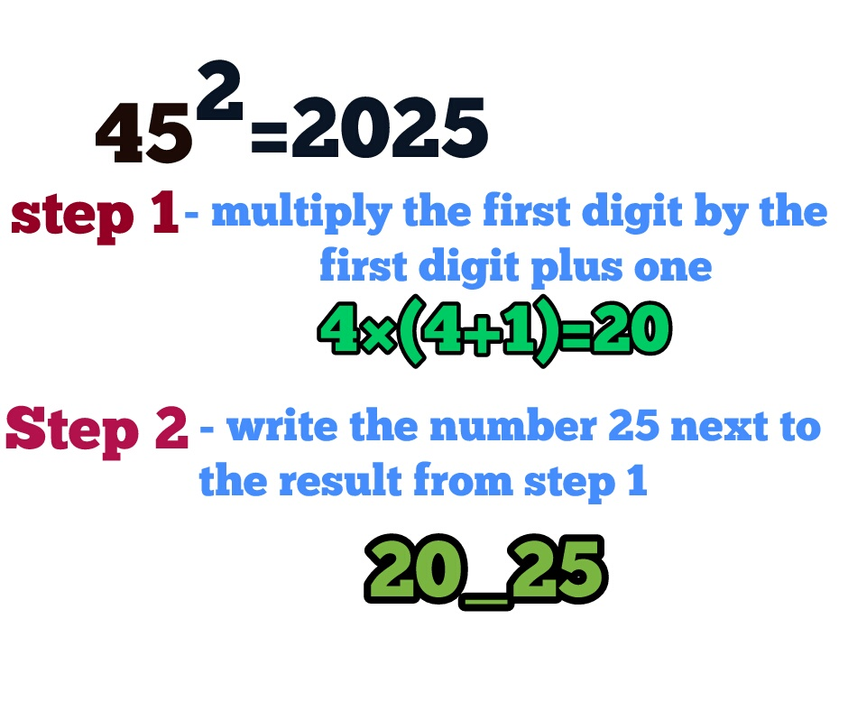
SQUARE OF NUMBER ENDING WITH 5

Slide 29
APPLICATION
24. Find the square of 55?
A) 2025 B) 3225 C) 3025 D) 2525
25. Find the square of 95?
A) 9025 B) 9925 C) 7225 D) NONE
26. Find the square of 65?
A) 4825 B) 4225 C) 3625 D) 3025
Notes:
24. Correct Option: C
25. Correct Option: A
26. Correct Option: B

Slide 30
SQUARE ROOT SHORTCUTS (For Perfect Square Numbers Only)
Step 1: Check unit digit of the no. (in pair).
Step 2: Select whose square less than remaining no.
Step 3: Multiply no. with consecutively next no.
Step 4: Compare & select
Example:12544
11 2 or 8
11²<125<12²
Now, 11*12 = 132
125<132; So, we’ll choose the smaller number i.e. 11.
Answer will be 112
Number | Square | Last digit
1 | 1 | 1
2 | 4 | 4
3 | 9 | 9
4 | 16 | 6
5 | 25 | 5
6 | 36 | 6
7 | 49 | 9
8 | 64 | 4
9 | 81 | 1

Slide 31
APPLICATION
27. Find the square root of 14641?
A) 121 B) 91 C) 111 D) 141
28. Find the square root of 233289?
A) 587 B) 377 C) 483 D) 733
Notes:
27. Correct Option: A
28. Correct Option: C

Slide 32
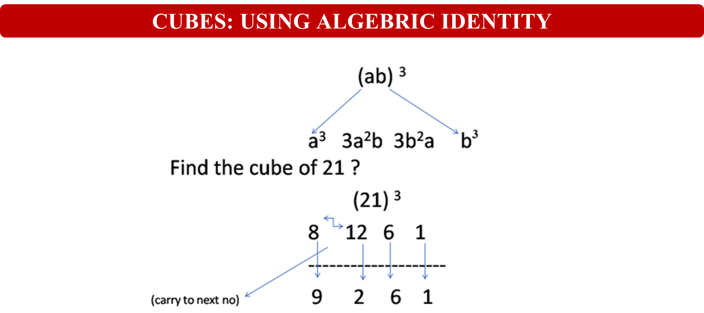

Slide 33
APPLICATION
29. Find the Cube of 17?
4179 B) 4963 C) 3821 D) 4913
30. Find the Cube of 24?
A) 14178 B) 14964 C) 13824 D) 13148
31. Find the Cube of 73?
A) 384131 B) 389017 C) 413141 D) 361487
Notes:
29. Correct Option: D
30. Correct Option: C
31 Correct option: B

Slide 34
CUBE ROOT SHORTCUTS
Step 1: Check unit digit and write its corresponding last digit number
Step 2: Ignore the last three digits
Step 3:Select whose cube is less than or equal to the remaining digit.
Step 4: Write that number with the corresponding number
Number | Cube | Last digit
1 | 1 | 1
2 | 8 | 8
3 | 27 | 7
4 | 64 | 4
5 | 125 | 5
6 | 216 | 6
7 | 343 | 3
8 | 512 | 2
9 | 729 | 9
Example:110592
8
4³
Now, 48 will be the answer

Slide 35
APPLICATION
32.Find the cube root of 5832?
A) 14 B) 18 C) 16 D) 22
33.Find the cube root of 24389?
A) 33 B) 43 C) 23 D) 29
Notes:
32. Correct Option: B
33. Correct Option: D

Slide 36
BODMAS
What is BODMAS?
BODMAS is a rule used to solve mathematical expressions in the correct order. It stands for:
B → Brackets
O → Of/Orders (powers, roots, etc.)
D → Division
M → Multiplication
A → Addition
S → Subtraction

Slide 37
APPLICATION
Solve: 120 + 15 × 20 ÷ 10.
Sol:
Applying BODMAS rule:
Step 1: First solve Divide
120 + 15 × 20 /10
120 +15 x 2
Step 2 : Now Solve multiplication
120+30
Step 3 : Now Add
150

Slide 38
APPLICATION
34. What will come in place of question mark (?) in the following equation?
575 - 95 + 120 + 25 = ?²
5
125
25
625
Notes:
Correct Option: C
575 – 95 +120+25 = ?^2
480+120+25 = ?^2
625 = ?^2
? = 25

Slide 39
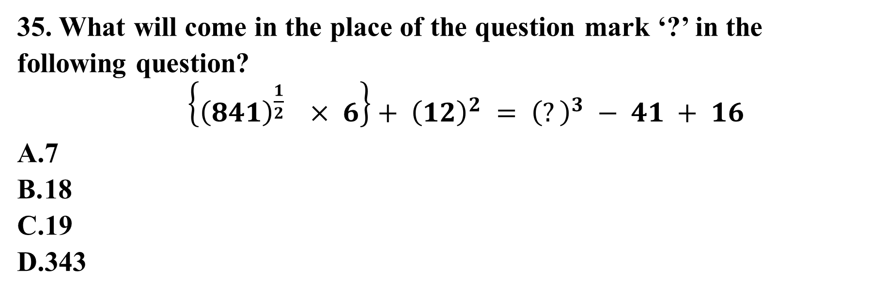
APPLICATION
Notes:
Correct Option A
Follow BODMAS rule to solve this question,
{(841)^(^{1/2)} × 6} + (12)^² = (?)^³ − 41 + 16
⇒ (29 × 6)+ 144 = ?^³ − 41 + 16
⇒ 174 + 144 = ?^³ − 41 + 16
⇒ 318= ?^³ − 41 + 16
⇒ 318+ 41 − 16= ?^³
⇒ 359 − 16 = ?^³
⇒ ?^³ = 343
∴ ? = 7

Slide 40
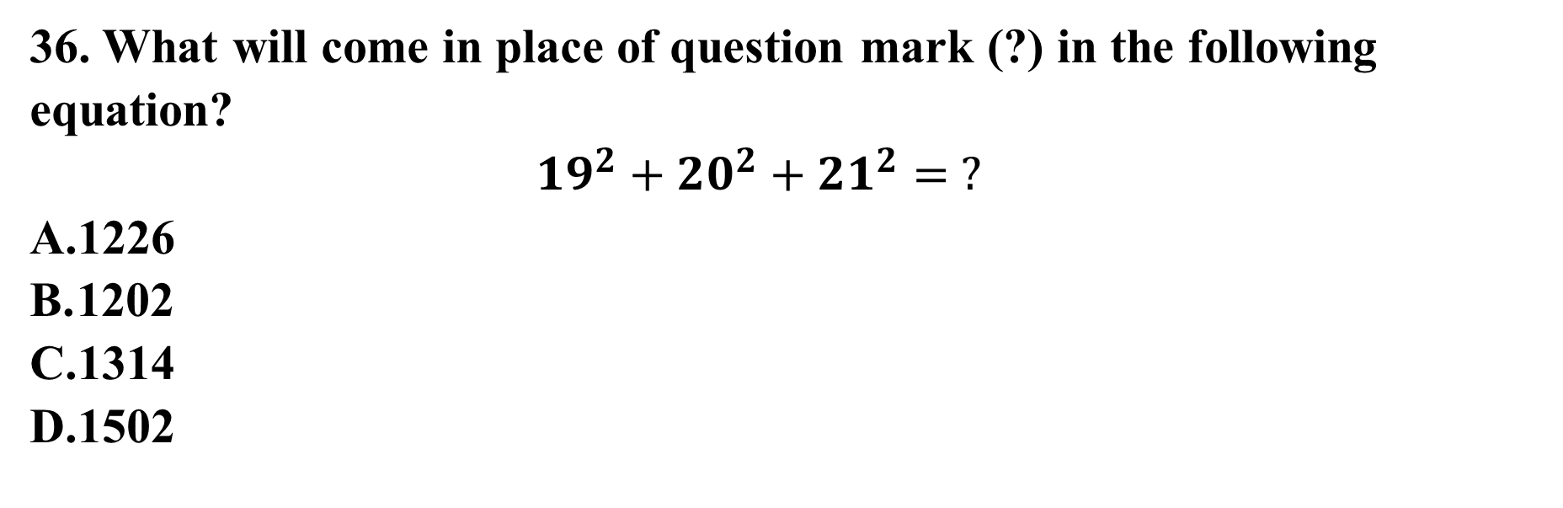
APPLICATION
Notes:
Correct Option : B
19^2+20^2+21^2= ?
361+400+441= ?
𝟏𝟐𝟎𝟐=?

Slide 41
APPLICATION
37. Find the value of given expression
[76 – {90 ÷ 5 x (24 – 36 ÷ 3) ÷ 3}]
77.5
71.5
75.5
4
Notes:
Correct Option D
[76 – {90 ÷ 5 ⨯ (24 – 36 ÷ 3) ÷ 3}]
⇒ [76 – {90 ÷ 5 ⨯ (24 – 36 × 1/3) ÷ 3}]
⇒ [76 – {90 ÷ 5 ⨯ (24 – 12) ÷ 3}]
⇒ [76 – {90 × 1/5 ⨯ 12 × 1/3}]
⇒ [76 – {18 × 4}]
⇒ [76 – 72]
⇒ 4

Slide 42
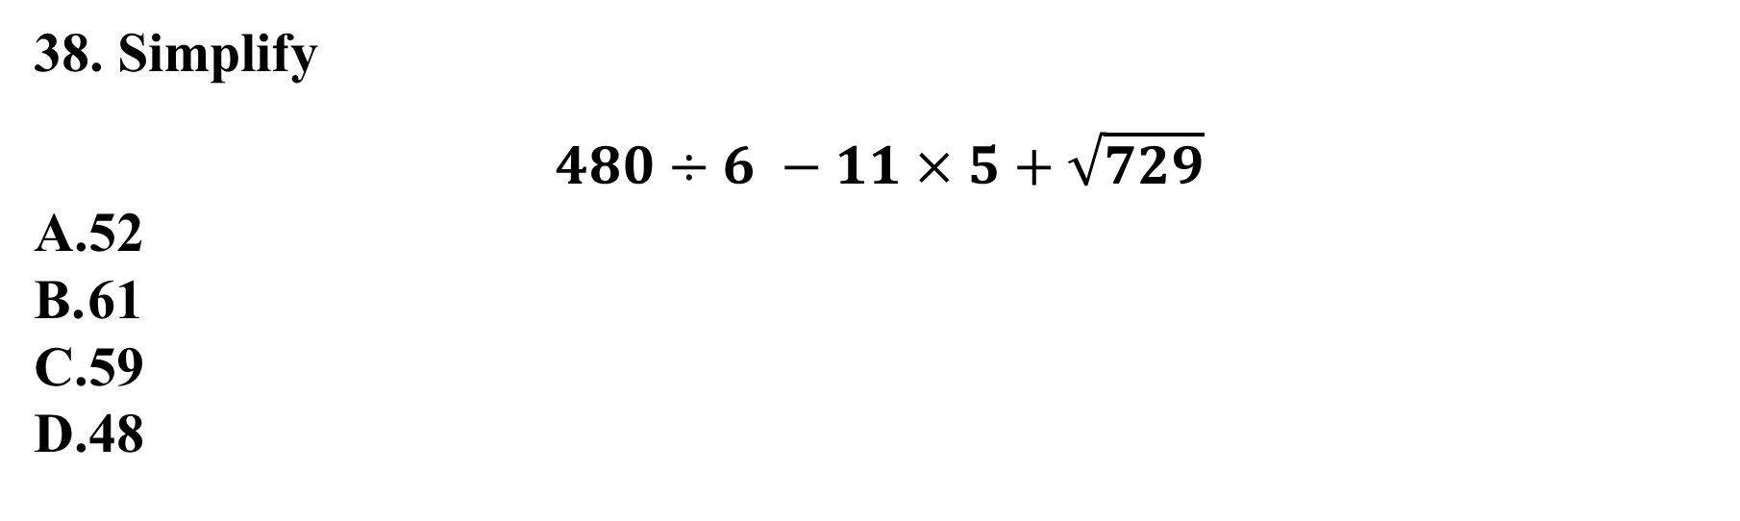
APPLICATION
Notes:
Correct Option A
480/6 - 11 × 5 + √729
⇒ 80 - 55 + 27
⇒ 107 - 55
⇒ 52

Slide 43
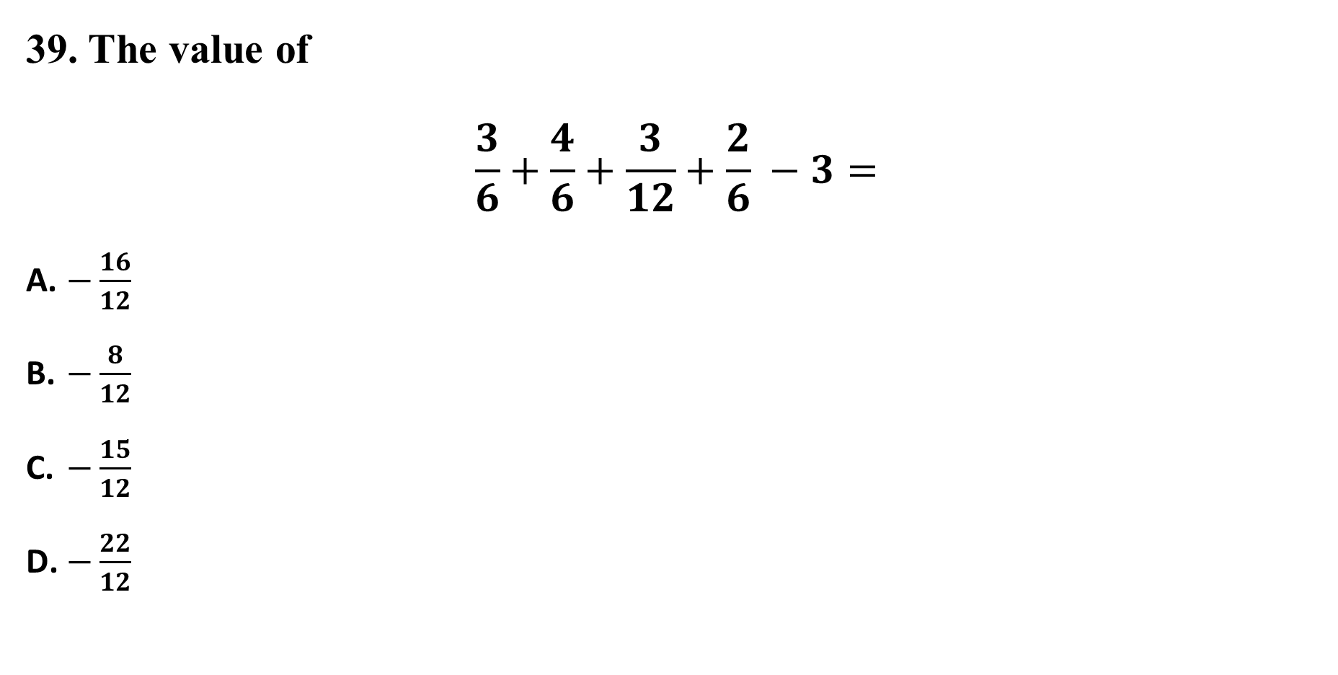
APPLICATION
Notes:
Correct Option: C
Taking lcm
(6+8+3+4−36)/12=−15/12

Slide 44
APPLICATION
APPLICATION
40. Simplify
162 ÷ [8 ÷ 4 x {13 + 14 - (3 + 10 - (7 + 6))}.
-3
3
11
8
Notes:
Correct Option: B
Using BODMAS RULE
⇒ 162 ÷ [8 ÷ 4 × {13 + 14 - (3 + 10 - 13)}]
⇒ 162 ÷ [2 × {27 - (13 - 13)}]
⇒ 162 ÷ [2 × {27 - 0}]
⇒ 162 ÷ [2 × 27]
⇒ 162 ÷ 54
⇒ 3

Slide 45
Ensure attainment of LOs in alignment to the learning activities: outcomes (1-2)
Outcome 1: Students are able to use Vedic Maths methods to speed up calculations and reduce error.
Outcome 2: Students can simplify complex expressions efficiently and solve aptitude-based simplification problems with accuracy.

Slide 46
Information about the next lesson

Slide 47
Review and Reflection from students

